Slide 1

WOMEN SAFETY SYSTEM
PRESENTED BY
K. Udaya Shankar 203B5A0409
A. Ravi Raja 203B5A0401
Ch. Mercy Glory 203B5A0404
N.N.M.L. Prasad 203B5A0415
V. Madhu Latha 193B1A0421
UNDER THE GUIDANCE OF
S. Siva Krishna, M.Tech
ASSISITANT PROFESSOR

Slide 2
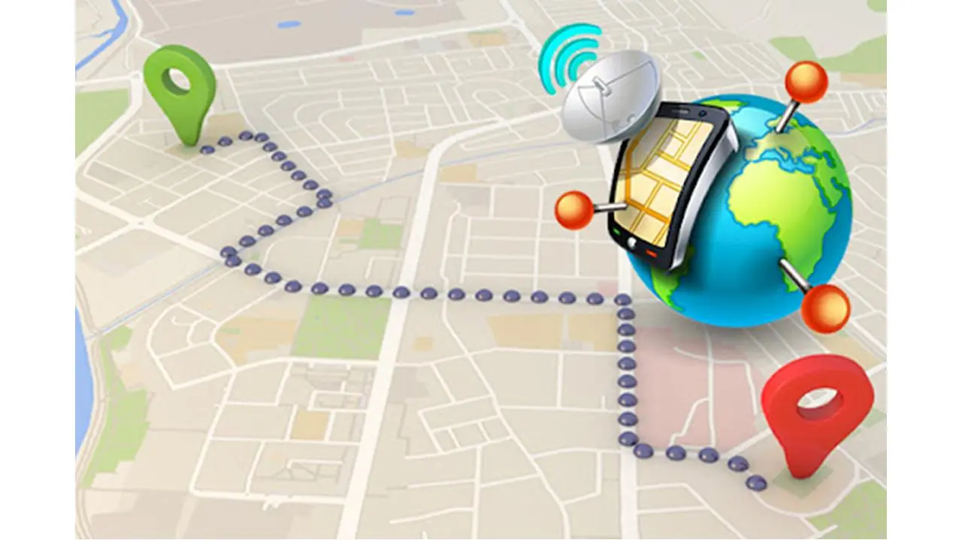
Abstract
The system aims to provide real-time protection to women in emergency situations. The system is equipped with a GPS module (Neo 6m v2) which provides the current location of the user. This information is sent to a designated guardian or emergency contact via SMS using the SIM 800L GSM module. In case the user presses the emergency button, the system sends an SMS to the designated guardian with the user's current location and an emergency message.
The system uses the ESP 32 microcontroller to integrate all the components and ensure their seamless operation. The microcontroller ensures that the system is constantly monitoring the user's location and sending regular updates to the guardian. In case of an emergency, the microcontroller sends an emergency alert to the designated guardian. The system is designed to be portable and can be carried by the user at all times. The compact size and low power consumption of the components ensure that the system is convenient to use and can be operated for extended periods on a single charge.
Overall, the woman safety system using the SIM 800L GSM module, Neo 6m v2 GPS module, and ESP 32 microcontroller is a reliable and effective solution for providing real-time protection to women in emergency situations.

Slide 3
CONTENTS
Existed solution
Block diagram
Components
Features
Application

Slide 4
Existed solution
As the number of crimes increased against women that has growing as a planted seeds of fear and security in the minds of Indian people and other countries people ,because of these fears ultimately end point in the imposition of restrictions and strict rules every women has compromise with, willingly, unwillingly to win their goals and achievements . Instead of bringing the confidence in a young women and children, these restrictions normally and again turn them into meek beings dare less and uncap able of facing in front of the world. To get rid of the fear of family members and to help a woman and child move around with confidence and encouragement, many developers have made up with of many applications and some security devices.

Slide 5

PROPOSED SOLUTION
The proposed system describes a safety device that gets automatically triggered when a woman is in danger from anywhere at any time. This device has a transmitter and receiver in which the receiver is placed in a bag, and the transmitter is placed in the slipper. When the RF signal between the receiver and transmitter goes low, the device automatically sends SMS to the emergency contacts and provides alert to the nearby people. Here WiFi module and GPS are used. GPS is used to track the location of the women, and the WiFi module is used to send the tracked location as SMS to the emergency contacts.

Slide 6
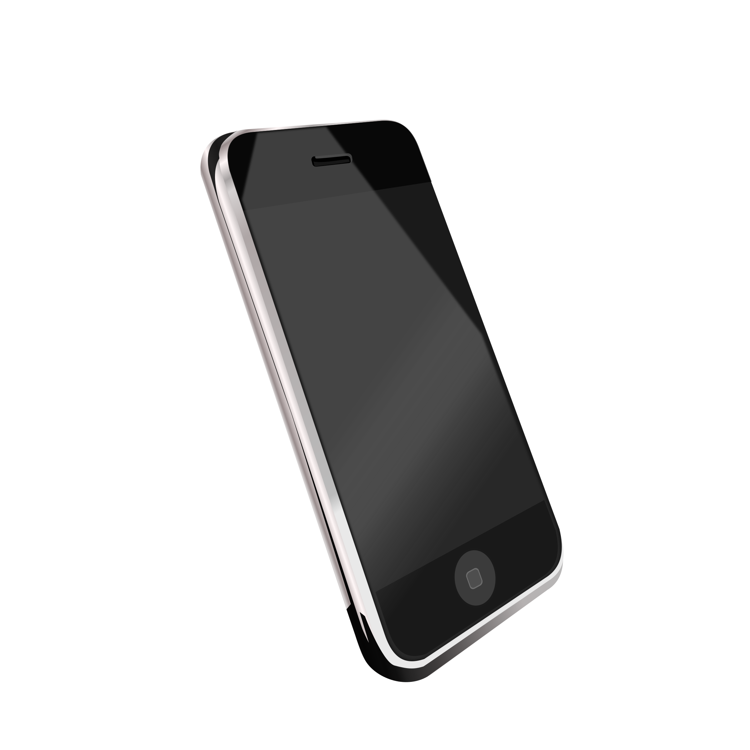
Block Diagram
Cloud
Sim
Live Location
Mobile
GSM/GPRS
This is for sharing information
(API)
DC 5v or 12v
(For charging)
Lithium ion battery
ESP32 mc
For controlling the system
GPS
For sending location co-ordinates to micro controller

Slide 7
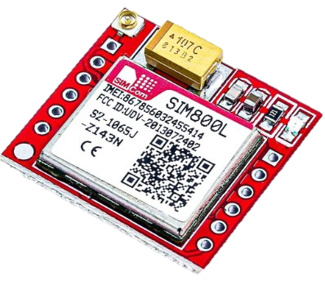
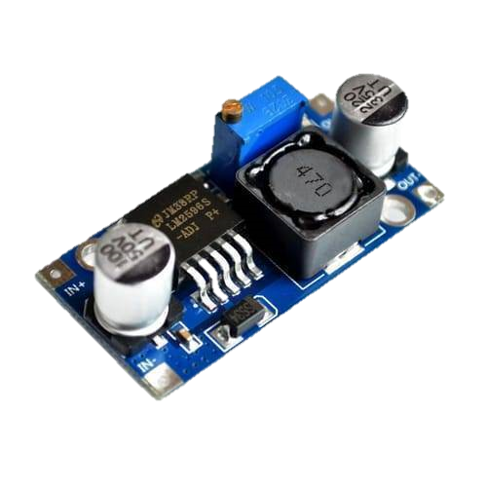
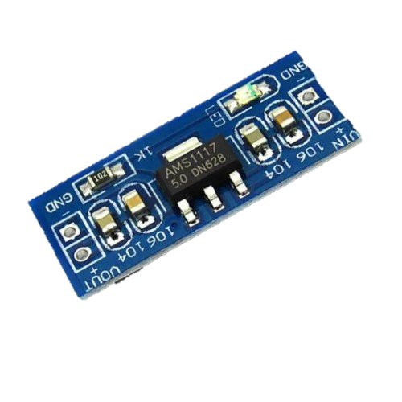
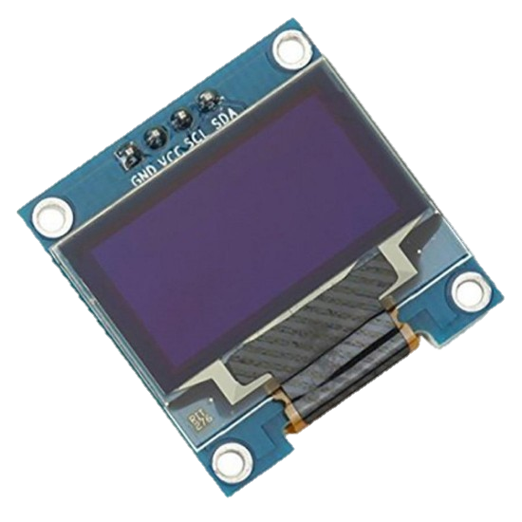
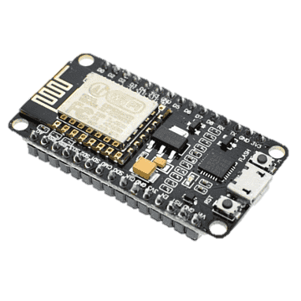
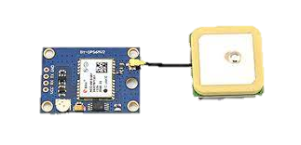
Components
ESP 32 Micro Controller
Sim 800L gsm Module
Neo 6m v2 gps Module
API
DC – DC Buck Converter
5v Step Down Power Supply Module
OLED Display

Slide 8
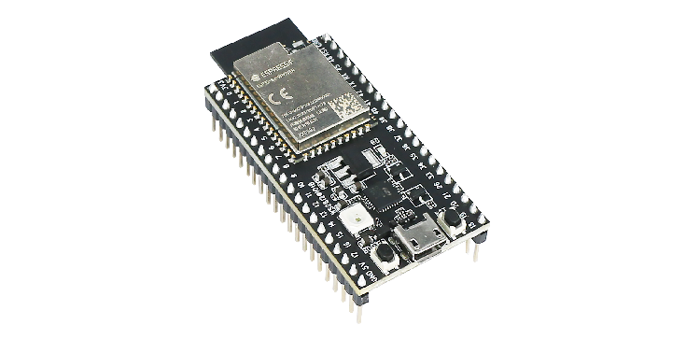
ESP 32 Micro Controller
The ESP32 is a popular microcontroller designed and manufactured by Espressif Systems. It is a highly versatile chip that includes both Wi-Fi and Bluetooth connectivity, as well as a dual-core 32-bit processor, which makes it suitable for a wide range of applications, including IoT devices, wearables, and automation projects.
Dual-core 32-bit processor: The ESP32 is powered by a dual-core Tensilica LX6 32-bit processor, which allows for better performance and power efficiency.
Wi-Fi and Bluetooth connectivity: The ESP32 includes built-in Wi-Fi and Bluetooth connectivity, making it easy to connect to a wide range of devices and networks.
Low power consumption: The ESP32 is designed to be energy-efficient, which makes it suitable for battery-powered applications.
Large memory capacity: The ESP32 includes up to 4MB of Flash memory and 520KB of SRAM, which makes it suitable for applications that require a lot of data storage.

Slide 9
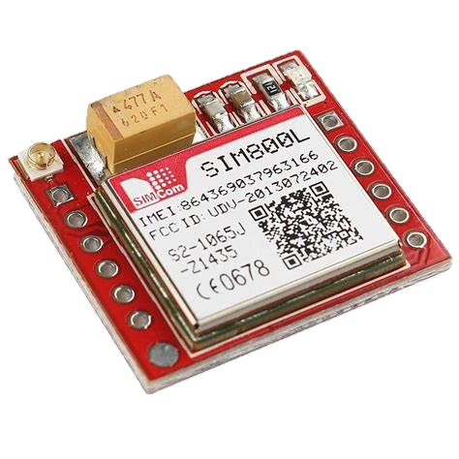
Sim800L GSM module
SIM800L GSM/GPRS module is a miniature cellular GSM modem from Simcom, which can easily interface with any microcontroller to give the microcontroller GSM functionality, and allows for GPRS transmission. This module connects the microcontroller to the mobile network to make or receive phone calls, send or receive SMS (text messages), and connect to the internet using GPRS, TCP, or IP. Another advantage is It supports quad-band GSM/GPRS network, which means it can work anywhere in the world. These important functionalities as well as the low cost and small footprint make this module more perfect for any project where long-range connectivity is required and also it can be integrated into a great number of IoT projects.

Slide 10
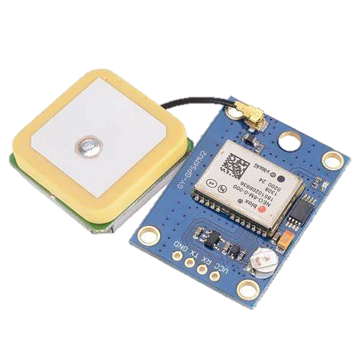
Neo 6m v2 GPS Module
The NEO-6M V2 GPS module is a popular embedded system that provides accurate position and time information to various electronic devices. It is commonly used in applications such as navigation, geolocation, and tracking.
The NEO-6M V2 GPS module is developed by u-blox and it supports the Global Navigation Satellite System (GNSS). It can receive signals from various satellite systems such as GPS, GLONASS, and Galileo. The module has an onboard microcontroller unit (MCU) that can process the satellite signals and provide the device with the precise location, altitude, speed, and time information.

Slide 11

Application Programming Interface (API)
API stands for Application Programming Interface An API is a set of defined rules that explain how computers or applications communicate with one another. APIs sit between an application and the web server, acting as an intermediary layer that processes data transfer between systems.
So API intermediate to the application and the Woman Safety System device. Th e all the device is every 5mins to connect to the API

Slide 12
_{DC – DC Buck Converter}
A buck converter or step-down converter is a DC-to-DC converter which steps down voltage (while stepping up current) from its input (supply) to its output (load). It is a class of switched-mode power supply. Switching converters (such as buck converters) provide much greater power efficiency as DC-to-DC converters than linear regulators, which are simpler circuits that lower voltages by dissipating power as heat, but do not step up output current. The efficiency of buck converters can be very high, often over 90%, making them useful for tasks such as converting a computer's main supply voltage, which is usually 12 V, down to lower voltages needed by USB, DRAM and the CPU, which are usually 5, 3.3 or 1.8 V.

Slide 13
5v Step Down Power Supply Module
This power supply module is based on the AMS1117 3.3V regulator. It is capable of regulating a wide range of input voltage (4.0 to 12V) down to a fixed 3.3V output at up to 1A (Vin = 4.5V). Standard 0.1" header pins provide a means of connecting to its input and output terminals. These header pins have also been conveniently placed so that the module can be inserted face down into standard

Slide 14
_{OLED Display}
OLED (Organic Light-Emitting Diode) is a self light-emitting technology composed of a thin, multi-layered organic film placed between an anode and cathode. In contrast to LCD technology, OLED does not require a backlight. OLED possesses high application potential for virtually all types of displays and is regarded as the ultimate technology for the next generation of flat-panel display
This 2.44 cm (0.96 Inch) I2C/IIC 4pin OLED Display Module BLUE can be interfaced with any microcontroller using SPI/IIC/I2C protocols. It is having a resolution of 128x64. The package includes display board, display, 4 pin male header pre-soldered to board.
OLED monochrome 128x64 dot matrix display module. The characteristics of this display module are high brightness, self-emission, high contrast ratio, slim/thin outline, wide viewing angle, wide temperature range and low power consumption.

Slide 15

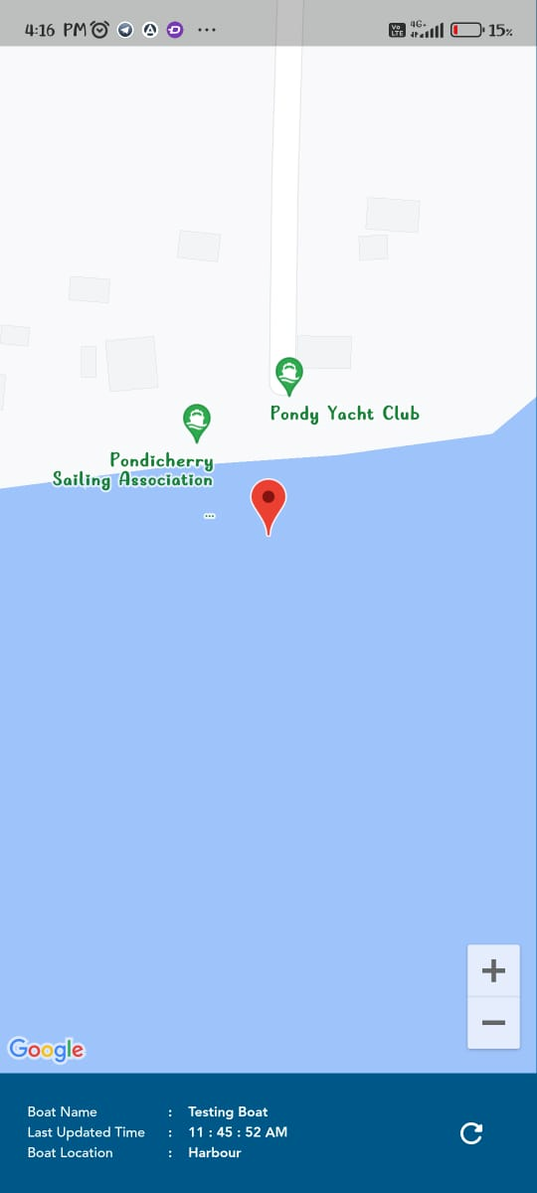
_{APP Interface}
Over app interface is shown in figure. When the device is on position if activate the emergency alert message is sent to the trust guardians open the message such as a file to click it then the app is open location is open the find the exact location shown in the application. This over app interface

Slide 16
Working
The button switches are used to trigger an emergency alarm or send an alert message to the user's trusted contacts.
If any of the sensors detect a potential threat, the ESP 32 board will trigger an alert by sending an SMS or call to the user's trusted contacts using the SIM800L GSM module.
The NEO 6M V2 GPS module is used to provide the user's current location to the trusted contacts, enabling them to respond quickly.
The user can also trigger an emergency alarm or send a distress signal by pressing the button switches, which will activate the alert system.
The system can also be configured to send an automatic alert if the user's movements are erratic or if the device detects a sudden drop or impact.

Slide 17

Features
Portable and easy carry
Live location tracking

Slide 18
Applications
Personal safety alarm
GPS tracking
Emergency messaging
Remote monitoring

Slide 19
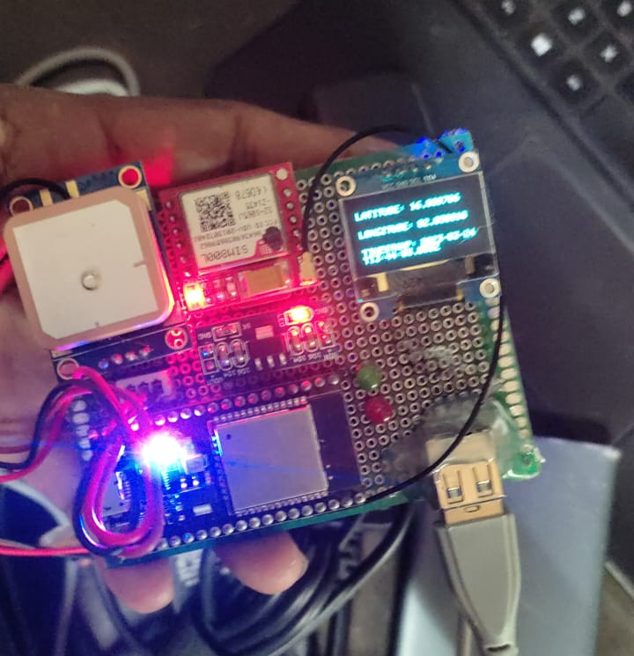
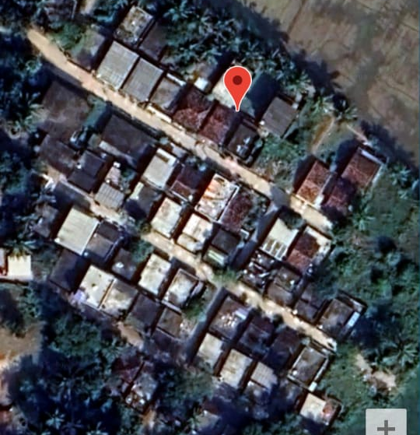
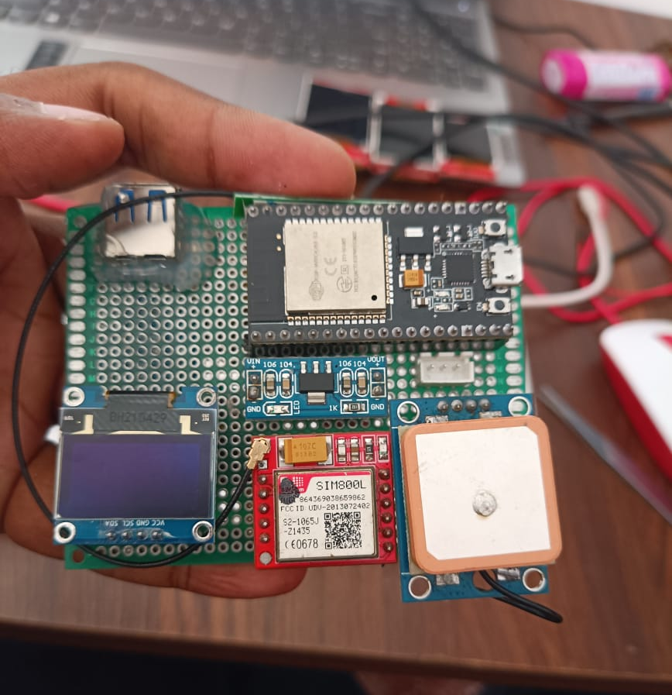
_{RESULT}

Slide 20
CONCLUSION
In conclusion, the woman safety system using ESP32, NEO 6M V2 GPS tracker, and SIM 800L GSM module is an effective and efficient system designed to ensure the safety of women. With this system, women can feel safe and secure, knowing that their location is constantly being monitored, and they can send an SOS message in case of an emergency. The ESP32 provides the necessary computational power to control the system, while the NEO 6M V2 GPS tracker allows for accurate location tracking. The SIM 800L GSM module facilitates communication with emergency services and loved ones. This system can be a game-changer in ensuring women's safety, and it has the potential to save lives.

Slide 21
_{FUTURE SCOPE}
In terms of the future scope, there are several possibilities. Firstly, the technology can be further improved by incorporating more advanced sensors, such as accelerometers or heart rate monitors, to detect and report distress signals automatically. This would eliminate the need for manual intervention and improve the speed and accuracy of the system.
Secondly, the system can be integrated with smart home automation systems, such as Alexa or Google Home, to provide voice-activated emergency alerts and responses. This would make it even easier and more convenient for women to use the system, particularly in situations where they may not have access to a phone or other device.
Thirdly, the system can be integrated with social media platforms and other online services to provide a more comprehensive safety network for women. For example, it could be linked to Facebook or Twitter to allow users to quickly and easily share their location and status with their friends and family in real-time.

Slide 22

THANK YOU

